Slide 1

Basic SQL Queries

Slide 2
Outline
Create and Delete Database
Create and Delete Table
Insert records Into Table
Delete records into Table
Update or Modify records into Table
Read records from Table
Where and Order By Clause
Group By Clause
Aggregate function
Set operation
Sub Queries

Slide 3
Create and Delete Database
Create database online_event
Delete database online_event

Slide 4
Create Table
CREATE TABLE MyGuests ( id INT(6) UNSIGNED AUTO_INCREMENT PRIMARY KEY, firstname VARCHAR(30) NOT NULL, lastname VARCHAR(30) NOT NULL, email VARCHAR(50), reg_date TIMESTAMP DEFAULT CURRENT_TIMESTAMP ON UPDATE CURRENT_TIMESTAMP )
MyGuests
id | firstname | lastname | email | reg_date

Slide 5
Delete Table
drop table MyGuests
MyGuests
id | firstname | lastname | email | reg_date

Slide 6
Insert records Into Table
INSERT INTO MyGuests (firstname, lastname, email)
VALUES
('John', 'Doe', 'john@example.com')
(‘zahid', hasan', ‘hasan@gmail.com')
MyGuests
id | firstname | lastname | email | reg_date
1 | John | Doe | john@example.com | 04-26-2020
2 | zahid | hasan | hasan.ice@gmail.com | 04-26-2020

Slide 7
Delete records Into Table
delete * from MyGuests
MyGuests
id | firstname | lastname | email | reg_date
1 | John | Doe | john@example.com | 04-26-2020
2 | zahid | hasan | hasan.ice@gmail.com | 04-26-2020

Slide 8
‘Where’ Clause
The WHERE clause is used to extract only those records that fulfill a specified condition.

Slide 9
Update or Modify records into Table
UPDATE MyGuests SET lastname=‘Abraham' id=1
WHERE
MyGuests
id | firstname | lastname | email | reg_date
1 | John | Abraham | john@example.com | 04-26-2020
2 | zahid | hasan | hasan.ice@gmail.com | 04-26-2020

Slide 10
Read records from Table
SELECT id, firstname, lastname FROM MyGuests
MyGuests
id | firstname | lastname
email | reg_date
1 | John | Abraham
john@example.com | 04-26-2020
2 | zahid | hasan
hasan.ice@gmail.com | 04-26-2020

Slide 11
Read Specific records from Table
SELECT * FROM MyGuests WHERE lastname='Abraham'
MyGuests
id | firstname | lastname
email | reg_date
1 | John | Abraham
john@example.com | 04-26-2020
2 | zahid | hasan | hasan.ice@gmail.com | 04-26-2020

Slide 12
Order By Clause
The ORDER BY clause is used to sort the result-set in ascending or descending order.
The ORDER BY clause sorts the records in ascending order by default. To sort the records in descending order, use the DESC keyword.
SELECT id, firstname, lastname
FROM MyGuests ORDER BY lastname
SELECT id, firstname, lastname
FROM MyGuests ORDER BY lastname
desc
MyGuests
MyGuests
id | firstname | lastname
id | firstname | lastname
1 | John | Abraham
2 | zahid | hasan
2 | zahid | hasan
1 | John | Abraham

Slide 13
Group By Clause
The GROUP BY statement groups rows that have the same values into summary rows, like "find the number of customers in each country".
The GROUP BY statement is often used with aggregate functions (COUNT, MAX, MIN, SUM, AVG) to group the result-set by one or more columns.

Slide 14
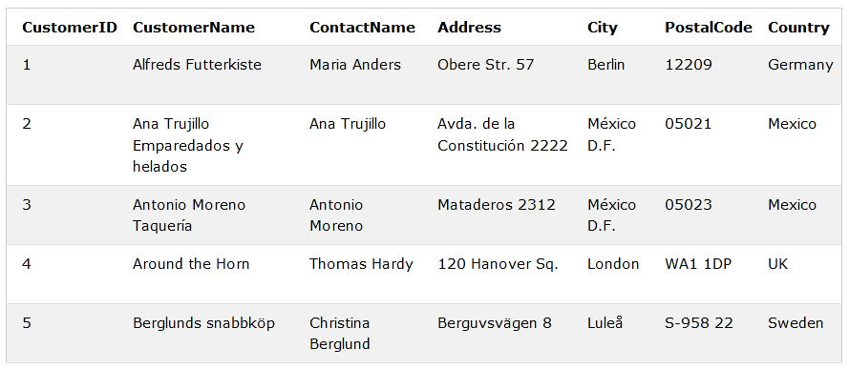
Group By Clause
Number | Country
1 | Germany
2 | Mexico
1 | UK
SELECT COUNT(CustomerID) as Number, Country FROM Customers GROUP BY Country;

Slide 15
AGGREGATE FUNCTIONS

Slide 16
AGGREGATE FUNCTIONS
Five (5) aggregate functions namely:
COUNT
SUM
AVG
MIN
MAX

Slide 17
Why use aggregate functions
From a business perspective, different organization levels have different information requirements. Top levels managers are usually interested in knowing whole figures and not necessary the individual details.
>Aggregate functions allow us to easily produce summarized data from our database.
For instance, from our test database , management may require following reports
> Least rented movies.
> Most rented movies.
> Average number that each movie is rented out in a month.

Slide 18
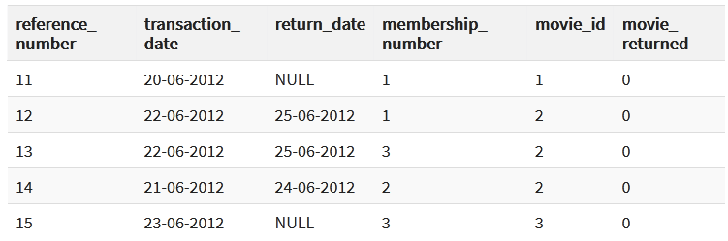
COUNT Function
movierentals
The COUNT function returns the total number of values in the specified field.
It works on both numeric and non-numeric data types.
Let's suppose that we want to get the number of times that the movie with id 2 has been rented out
SELECT COUNT(`movie_id`) FROM `movierentals` WHERE `movie_id` = 2;
Output: 3

Slide 19
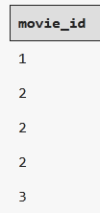

DISTINCT Keyword
movierentals
The DISTINCT keyword that allows us to omit duplicates from our results.
SELECT `movie_id` FROM `movierentals`;
SELECT DISTINCT `movie_id` FROM `movierentals`;

Slide 20
MIN function
Movies
The MIN function returns the smallest value in the specified table field.
Movie_Name | year_released
Sharlock holmes | 2003
Quarentine | 2005
As an example, let's suppose we want to know the year in which the oldest movie in our library was released
SELECT MIN(`year_released`) FROM `movies`;
Output: 2003

Slide 21
MAX function
Movies
The MAX function returns the highest value in the specified table field.
Movie_Name | year_released
Sharlock holmes | 2003
Quarentine | 2020
As an example, let's suppose we want to know the year in which the recent movie in our library was released
SELECT MAX(`year_released`) FROM `movies`;
Output: 2020

Slide 22
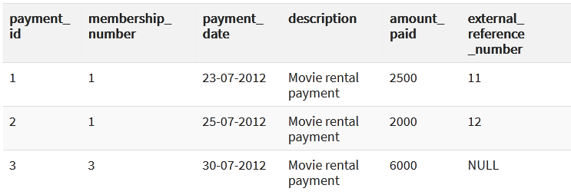
SUM function
payments
SUM function which returns the sum of all the values in the specified column.
SELECT SUM(`amount_paid`) FROM `payments`;
Output: 10500

Slide 23
AVG function
payments
AVG function returns the average of the values in a specified column.
SELECT AVG(`amount_paid`) FROM `payments`;
Output: 3500

Slide 24
Mysql Aliases
payments
MySQL aliases are used to give a table, or a column in a table, a temporary name.
Aliases are often used to make column names more readable.
An alias only exists for the duration of the query.
SELECT AVG(`amount_paid`) as Average FROM `payments`;
Average
3500

Slide 25
‘Between’ and ‘AND’
Select name from instructor where salary between 8000 and 12000;
instructor
instructor
Name | salary
Zahid | 1000
Morium | 6000
Bob | 15000
Sobuj | 8000
Moin | 11000
Name | salary
Sobuj | 8000
Moin | 11000

Slide 26
Delete Operation
Deletes all tuples from the instructor relation. The instructor relation itself still exists, but it is empty.
delete from instructor;

Slide 27
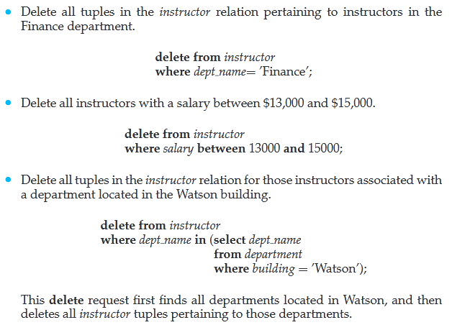
Delete Operation

Slide 28
Delete Operation
For example, suppose that we want to delete the records of all instructors with salary below the average at the university. We could write
delete from instructor where salary < (select avg (salary) from instructor);

Slide 29
Update Operation
Suppose that annual salary increases are being made, and salaries of all instructors are to be increased by 5 percent. We write
Update instructor set salary = salary * 1.05;
If a salary increase is to be paid only to instructors with salary of less than $70,000, we can write:
Update instructor set salary=salary * 1.05 where salary < 70000;

Slide 30
Update Operation
“Give a 5 percent salary raise to instructors whose salary is less than average ” as follows:
Update instructor set salary = salary * 1.05 where salary <
( select avg (salary) from instructor);

Slide 31


Ordering the Display of Tuples
To list in alphabetic order all instructors in the Physicsdepartment, we write:
We wish to list the entire instructor relation in descending order of salary. If several
instructors have the same salary, we order them in ascending order by name. We express this query in SQL as follows:

Slide 32
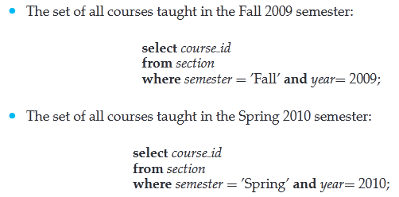
Set Operations
The SQL operations union, intersect, and except operate on relations and correspond to the mathematical set-theory operations ∪,∩, and −.

Slide 33
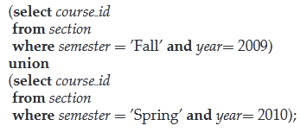
The Union Operation
To find the set of all courses taught either in Fall 2009 or in Spring 2010, or both, we write

Slide 34
The Union Operation
To find the set of all courses taught either in Fall 2009 or in Spring 2010, or both, we write

Slide 35
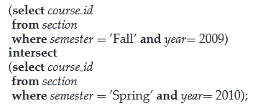
The Intersect Operation
To find the set of all courses taught in the Fall 2009 as well as in Spring 2010 we write:

Slide 36
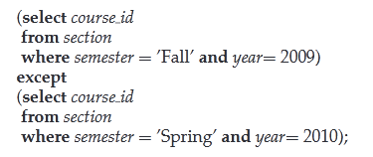
The Except Operation
To find all courses taught in the Fall 2009 semester but not in the Spring 2010 semester, we write:

Slide 37

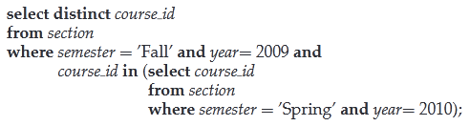
Nested Query using Set Operation
We begin by finding all courses taught in Spring 2010, and we write the subquery
We then need to find those courses that were taught in the Fall 2009 and that appear in the set of courses obtained in the subquery.

Slide 38
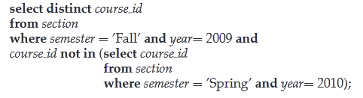
Nested Query using Set Operation
We use the not in construct in a way similar to the in construct.
For example, to find all the courses taught in the Fall 2009 semester but not in the Spring 2010semester, we can write:

Slide 39

Nested Query using Set Operation
The following query selects the names of instructors whose names are neither “Mozart” nor “Einstein”.

